Slide 1

Unsupervised Learning
K-Means Clustering
Agglomerative Clustering

Slide 2
Types of ML
In machine learning, there are two main types of learning:
Supervised Learning: You train with data that already has labels (like "Pass" or "Fail").
Unsupervised Learning: You train with unlabeled data, and the algorithm figures out patterns on its own.
The data has no labels (no "Pass"/"Fail", "Spam"/"Not Spam", etc.)
The goal is to find hidden patterns or structures in the data.
Group similar data points together (e.g., customers with similar buying habits).

Slide 3
K-Means Clustering
Clustering: Clustering means grouping data so that:
Points in the same group (cluster) are similar
Points in different groups are different
K-Means is a clustering algorithm that:
Divides data into K groups
Each group has a center (centroid)
Each point belongs to the group with the closest center

Slide 4
K-Means Clustering
K-Means Steps:
Choose K = number of clusters
Randomly pick K data points as starting centroids
Assign each point to the closest centroid
Recalculate the centroid of each cluster
Repeat steps 3–4 until points stop moving between clusters

Slide 5
Example: Segmenting Grocery Store Customers using K-Means
Imagine you're the owner of a supermarket. You have no labels saying what kind of customer each person is. But you do have this data:
Customer | Age | Spend
C1 | 22 | 2000
C2 | 25 | 2200
C3 | 23 | 1800
C4 | 40 | 6000
C5 | 42 | 5800
C6 | 39 | 6200

Slide 6

We will cluster into K = 2 clusters.
Step 1: Choose Initial Centroids
Let’s choose:
Centroid 1 (C1) = (22, 2000)
Centroid 2 (C2) = (40, 6000)
Step 2: Calculate Distance of Each Point to Both Centroids
We use the Euclidean Distance Formula:
x=Age
y=Spend

Slide 7
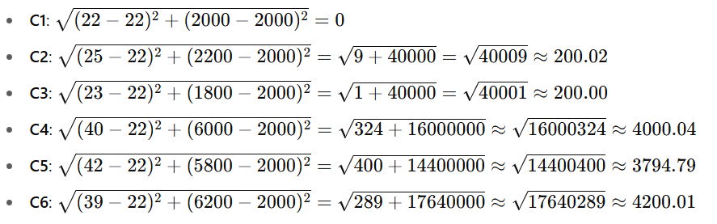
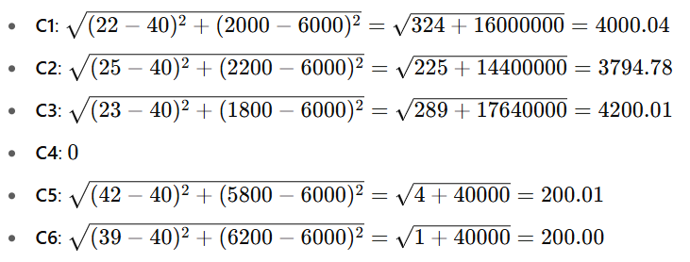
Distance to (C1) = (22, 2000):
Distance to (C2) = (40, 6000):

Slide 8
Step 3: Assign Each Customer to the Closest Centroid
Customer | Distance to C1 | Distance to C4 | Assigned Cluster
C1 | 0 | 4000.04 | Cluster 1
C2 | 200.02 | 3794.78 | Cluster 1
C3 | 200.00 | 4200.01 | Cluster 1
C4 | 4000.04 | 0 | Cluster 2
C5 | 3794.79 | 200.01 | Cluster 2
C6 | 4200.01 | 200.00 | Cluster 2
So, we now have:
Cluster 1: C1, C2, C3
Cluster 2: C4, C5, C6

Slide 9


Step 4: Recalculate the Centroids of Each Cluster
Cluster 1 (C1, C2, C3):
New Centroid 1 = (23.33, 2000)
2. Cluster 2 (C4, C5, C6):
New Centroid 2 = (40.33, 6000)

Slide 10
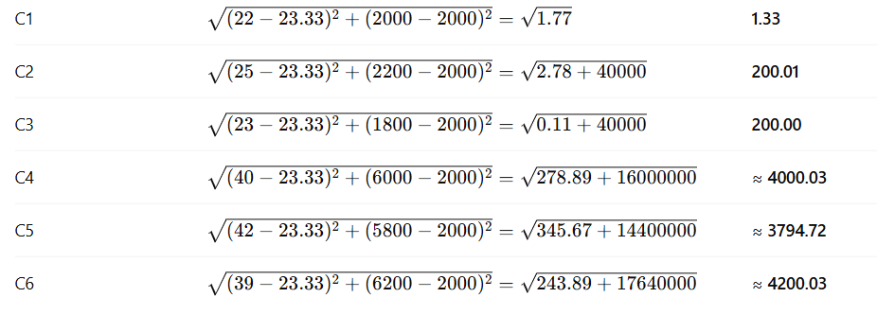
Step 5: Recalculate Distances to New Centroids
New Centroid 1 = (23.33, 2000)

Slide 11
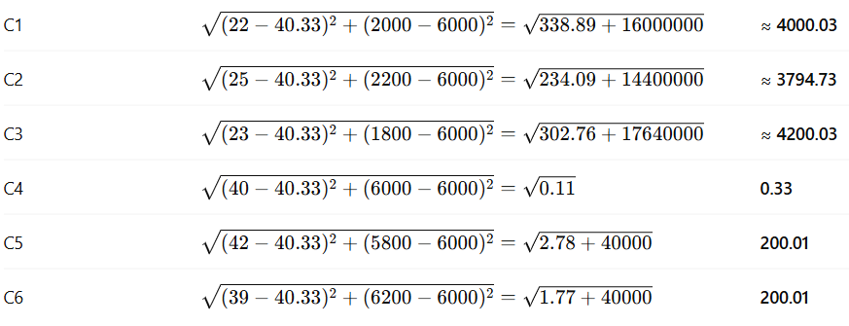
New Centroid 2 = (40.33, 6000)

Slide 12
Step 6: Reassign Clusters
Based on distances:
C1 → closer to Centroid 1 (1.33 vs. 4000.03)
C2 → Centroid 1 (200.01 vs. 3794.73)
C3 → Centroid 1 (200.00 vs. 4200.03)
C4 → Centroid 2 (4000.03 vs. 0.33)
C5 → Centroid 2 (3794.72 vs. 200.01)
C6 → Centroid 2 (4200.03 vs. 200.01)
No changes → K-Means has converged

Slide 13
Agglomerative Clustering (Hierarchical Clustering)
Agglomerative clustering is a type of Hierarchical Clustering. It uses a bottom-up approach:
Start with each data point as its own cluster
Step by step, merge the closest clusters
Continue merging until all points are in one big cluster or until we reach a desired number of clusters

Slide 14
Steps of Agglomerative Clustering:
Calculate distances between all data points
Merge the two closest points (clusters)
Update the distance matrix (based on linkage method)
Repeat steps 2–3 until:
A dendrogram (tree structure) is formed, or
You reach the desired number of clusters

Slide 15
Types of Linkage (How to measure distance between clusters)
Single Linkage: Min distance between any two points (closest pair)
Complete Linkage: Max distance between any two points (farthest pair)
Average Linkage: Average of all pairwise distances
We’ll use Single Linkage for this example.

Slide 16
Example
You own a small retail shop, and you have 5 customers. You tracked:
How much each customer spends per month
Their age
Now you want to group them based on similarity, but you don’t know in advance how many groups there are.
Customer | Age | Monthly Spend (Rs.)
C1 | 25 | 2000
C2 | 27 | 2200
C3 | 45 | 6000
C4 | 46 | 6100
C5 | 50 | 6300

Slide 17

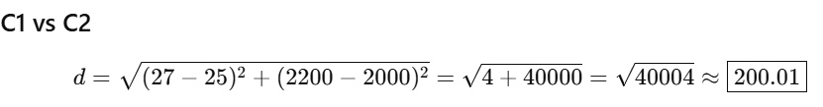
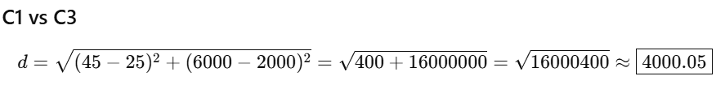
Step 1: Calculate All Pairwise Distances
 | C1 | C2 | C3 | C4 | C5
C1 | - | 200.01 | 4000.05 | 4100.05 | 4300.07
C2 | 200.01 | - | 3800.04 | 3900.05 | 4100.06
C3 | 4000.05 | 3800.04 | - | 100.00 | 300.04
C4 | 4100.05 | 3900.05 | 100.00 | - | 200.02
C5 | 4300.07 | 4100.06 | 300.04 | 200.02 | -

Slide 18
Step 2: First Merge
Minimum distance = 100.00 (between C3 and C4)
Merge → New Cluster: (C3C4)
Step 3: Update Distance Matrix
Clusters: C1, C2, C3C4, C5
Distance from (C3C4) to others (single linkage = minimum):
C1–C3 = 4000.05, C1–C4 = 4100.05 → min = 4000.05
C2–C3 = 3800.04, C2–C4 = 3900.05 → min = 3800.04
C5–C3 = 300.04, C5–C4 = 200.02 → min = 200.02
New Matrix
 | C1 | C2 | C3C4 | C5
C1 | - | 200.01 | 4000.05 | 4300.07
C2 | 200.01 | - | 3800.04 | 4100.06
C3C4 | 4000.05 | 3800.04 | - | 200.02
C5 | 4300.07 | 4100.06 | 200.02 | -

Slide 19
Step 4: Second Merge
Minimum distance = 200.01 (C1 and C2) Merge → New Cluster: (C1C2)
Step 5: Update Distance Matrix
Clusters: C1C2, C3C4, C5
Distance from (C1C2) to others:
C1–C3C4 = 4000.05, C2–C3C4 = 3800.04 → min = 3800.04
C1–C5 = 4300.07, C2–C5 = 4100.06 → min = 4100.06
New Matrix
 | C1C2 | C3C4 | C5
C1C2 | - | 3800.04 | 4100.06
C3C4 | 3800.04 | - | 200.02
C5 | 4100.06 | 200.02 | -

Slide 20
Step 6: Third Merge
Minimum distance = 200.02 (C3C4 and C5) Merge → New Cluster: (C3C4C5)
Step 7: Update Distance Matrix
Clusters: C1C2, C3C4C5
Distance between:
C1C2–C3C4C5 = min(3800.04, 4100.06) = 3800.04
Final Matrix
 | C1C2 | C3C4C5
C1C2 | - | 3800.04
C3C4C5 | 3800.04 | -

Slide 21
Step 8: Final Merge
Only 1 distance left = 3800.04 Merge → All customers now in one cluster
Final Dendrogram (Cluster Tree)
Final Clustering Options
(if we cut the dendrogram)
2 Clusters:
Group 1: C1, C2 (young, low spend)
Group 2: C3, C4, C5 (older, premium)
Level 4
Level 3
Level 2
Level 1
C1 C2 C3 C4 C5

Slide 22
Practice: Employee Segmentation
You’re analyzing employees at a company based on:
Years of Experience
Monthly Performance Score
Employee | Experience (Years) | Performance Score
E1 | 1 | 45
E2 | 2 | 50
E3 | 3 | 52
E4 | 4 | 47
E5 | 8 | 80
E6 | 9 | 78
E7 | 10 | 82
E8 | 11 | 83

